Slide 1
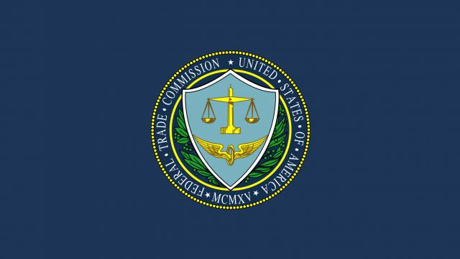



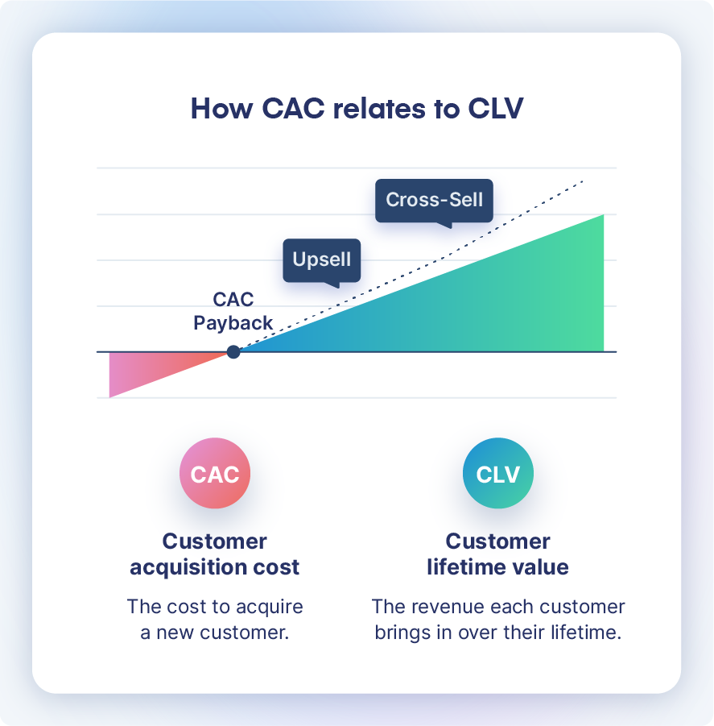
Enforcement Caselets (Illustrative)
US | 2023 | Regulator: FTC — Issue: Retail facial recognition harms (accuracy, false positives, inadequate controls). Outcome: Order restricting use; mandated safeguards and assessments; highlights UDAP risk for AI deployments.
EU (Italy) | 2023 | Regulator: Garante — Issue: LLM transparency, age-gating, and data rights. Outcome: Temporary restrictions lifted after remedial measures; signals strong transparency/data rights expectations.
US (NYC) | 2023–2024 | Regulator: DCWP — Issue: Automated employment decision tools (bias audit and notices). Outcome: Enforcement of bias audit and candidate disclosure requirements; employers adjust hiring AI workflows.
UK | 2022–2023 | Regulator: ICO — Issue: Facial recognition and web-scraped biometrics. Outcome: Orders and fines under data protection; subsequent appeals tested jurisdiction—signals scrutiny of biometric AI.
China | 2023–2024 | Regulator: CAC — Issue: Generative/deep synthesis services (labeling, filings). Outcome: Rectification and filing requirements before/after launch; emphasizes security review and content controls.
Note: Examples reflect applicable legal regimes (consumer protection, data protection, sector safety) used to police AI before/alongside AI-specific laws.

